Slide 1

PTU PORTAL FOR STUDENTS HIGHER EDUCATION
Guide : Dr.M.Thirumaran
B.Tech., M.Tech., Ph. D.
By : K. Syed Salahuddin (20CS427)

Slide 2
AGENDA
01 Problem statement
02 Hardware / Software
03 Use case Diagram
04 Database Design
05 UML Diagram
06 Screenshots

Slide 3

PROBLEM STATEMENT
The students have less aware about their Higher Studies.
They randomly search information from various resources.
Lack of knowledge and guidance for the running steps in studies.
Thus, as a solution the Portal for Student’s Higher Education will help them to gain more knowledge about the different streams.
Also develop their skills by the training providing by the portal.

Slide 4

Hardware/ Software Specification
HARDWARE USED
System : 64-bit Operating System – Windows 10.
Ram : 4 GB
Storage : 512 GB
SOFTWARE USED
• Frontend technologies:
- HTML
- CSS
- JavaScript
• Backend Technologies:
- PHP
- Ajax
• IDE:
- Visual Studio code
• Database:
- MySQL (XAMPP server)

Slide 5
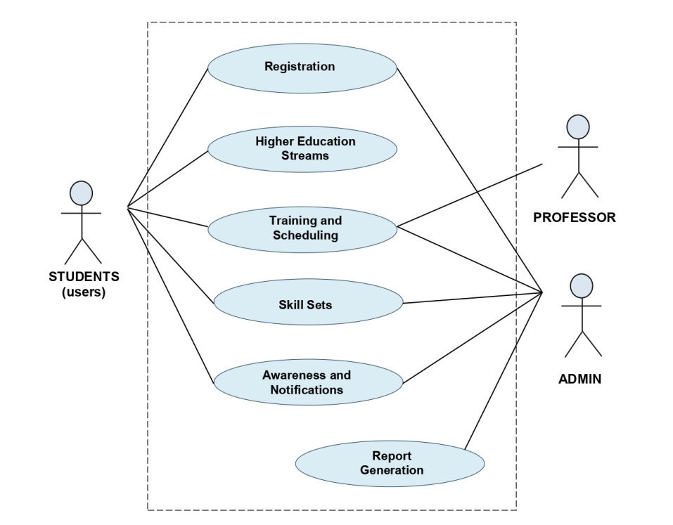
Use Case DIAGRAM

Slide 6
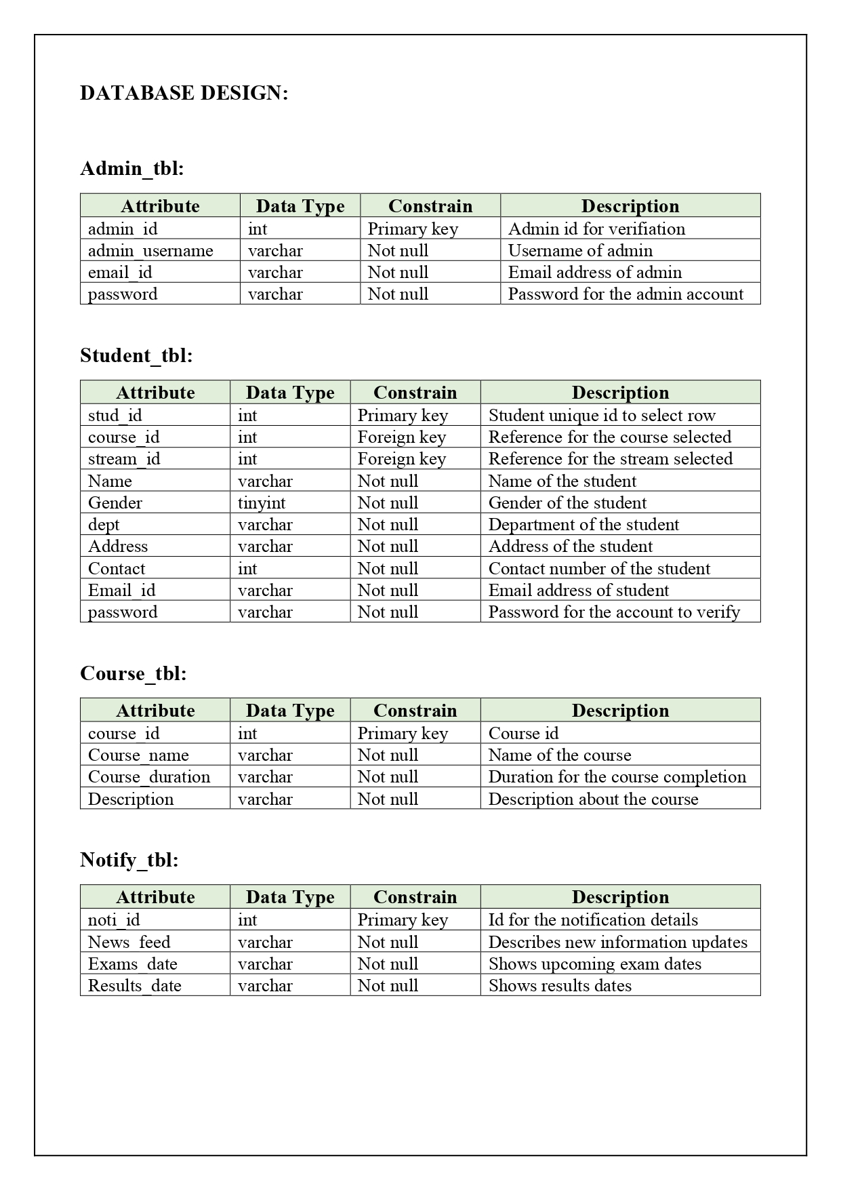

DATABASE DESIGN

Slide 7


Slide 8
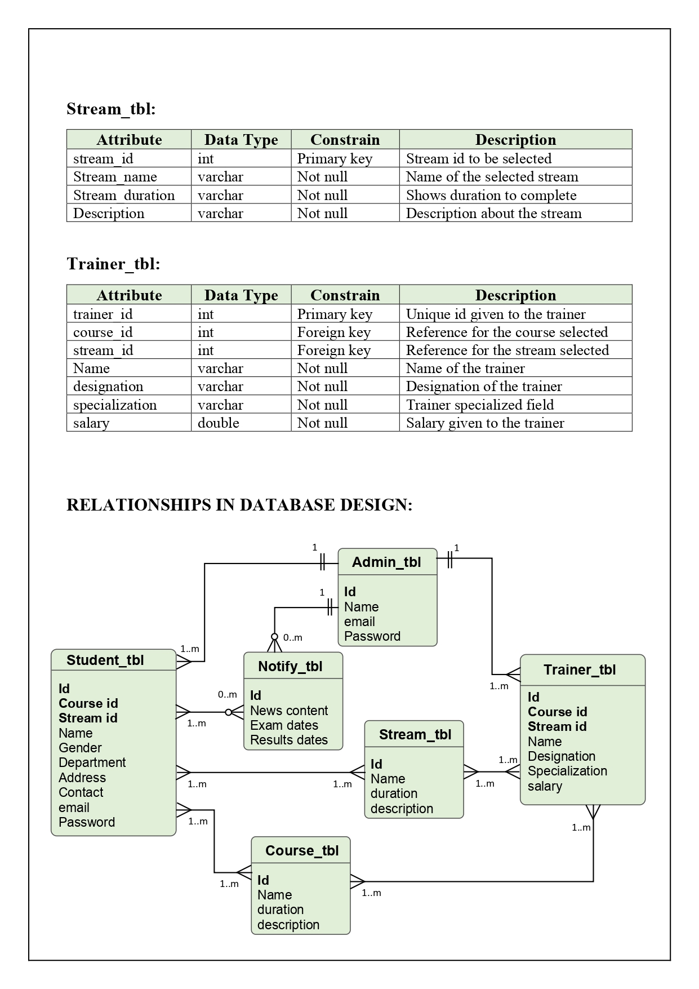


Slide 9

RELATION AMONG TABLES :

Slide 10
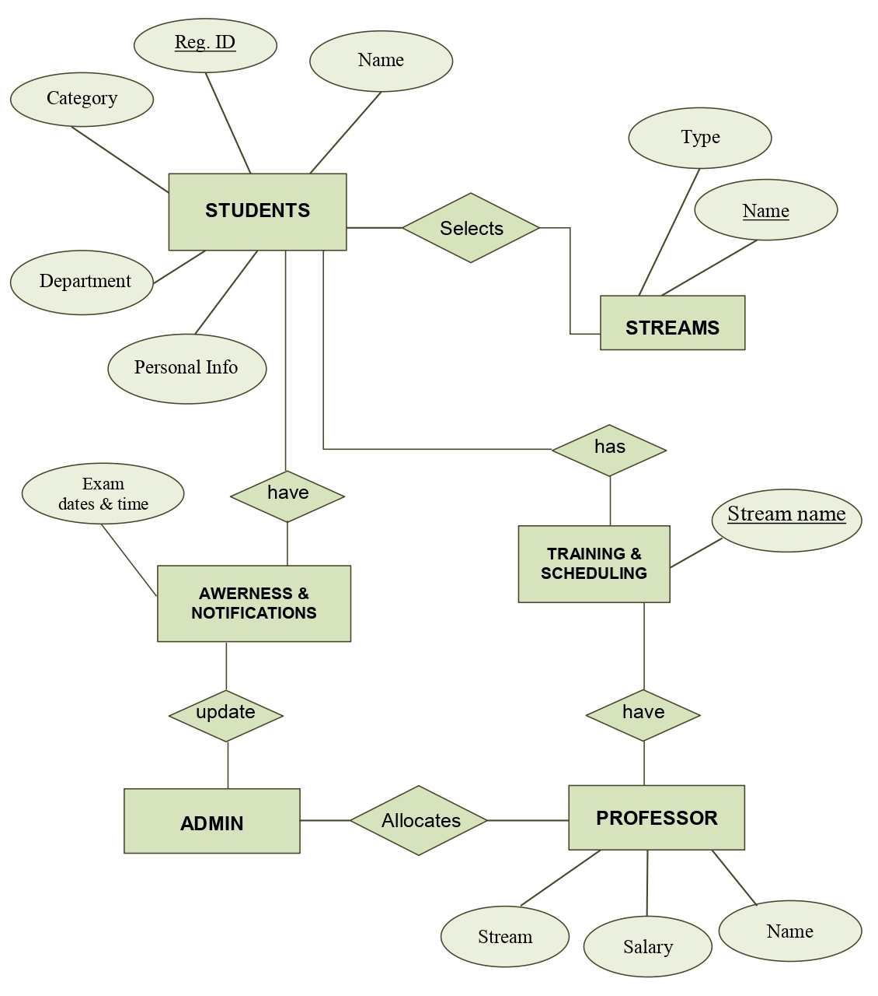
ER DIAGRAM

Slide 11
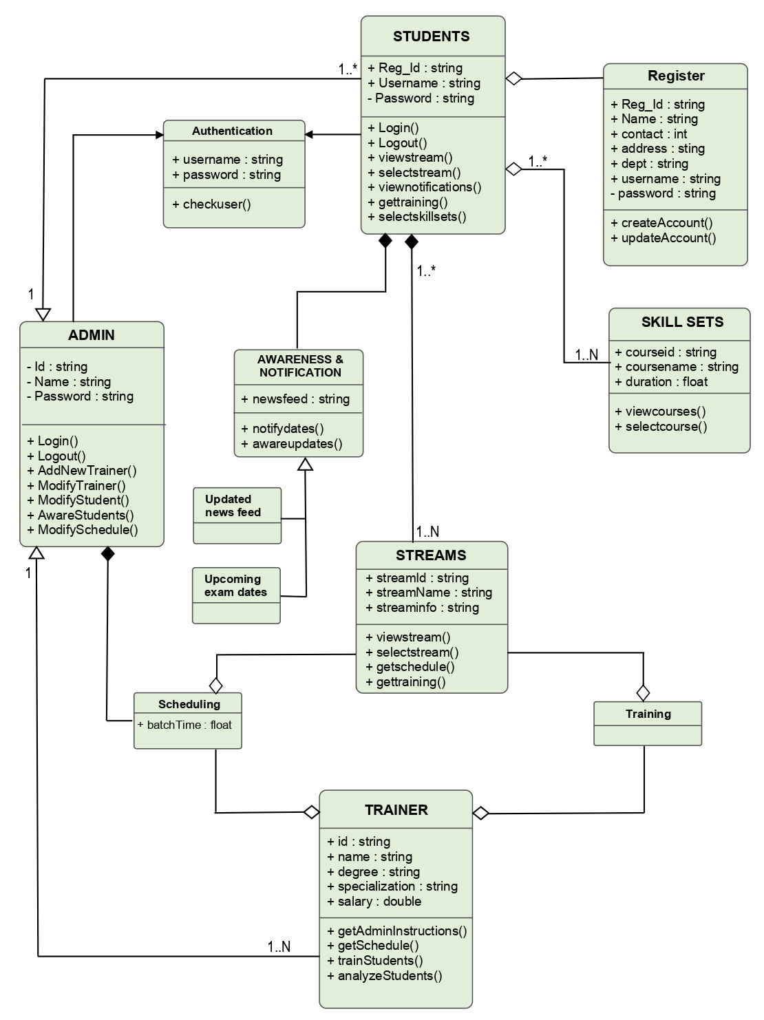
CLASS DIAGRAM
UML DIAGRAMS

Slide 12
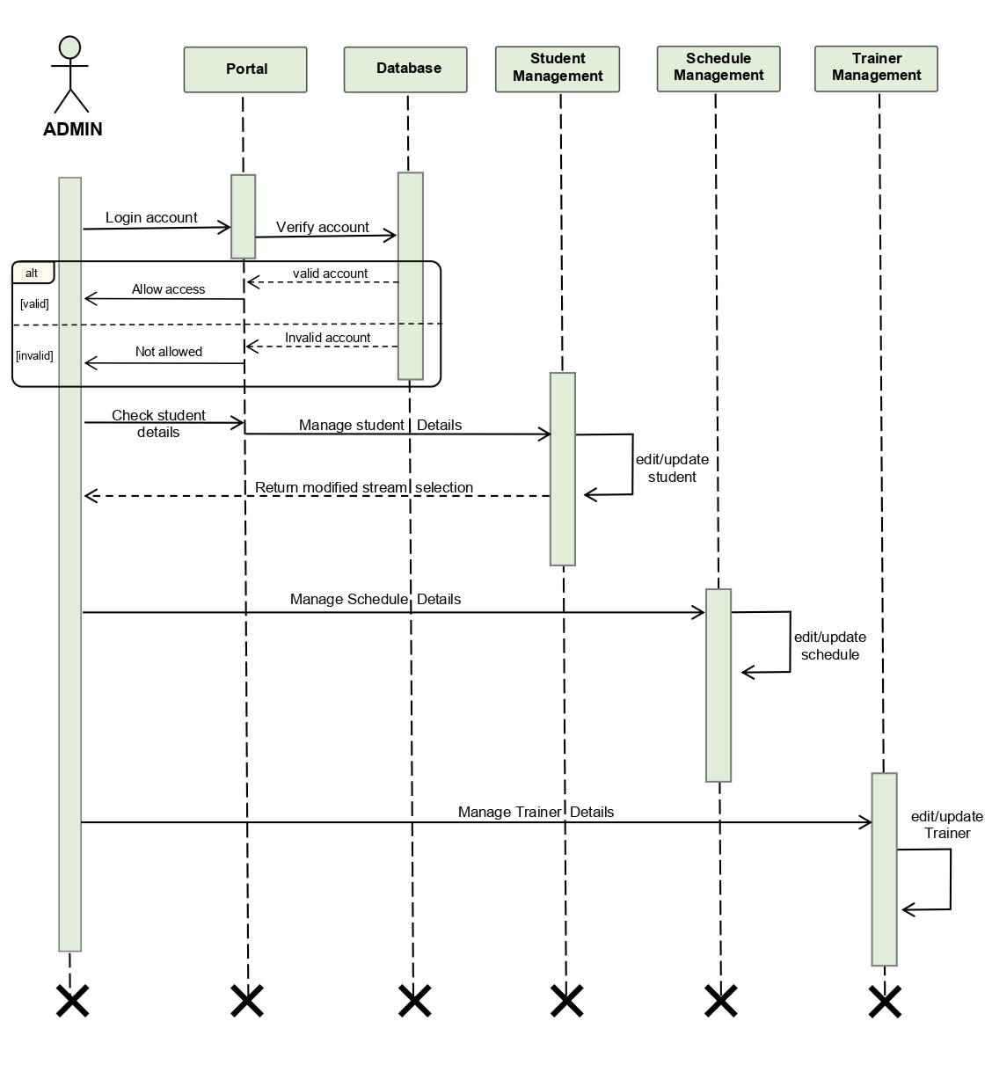
SEQUENCE DIAGRAM [admin]

Slide 13
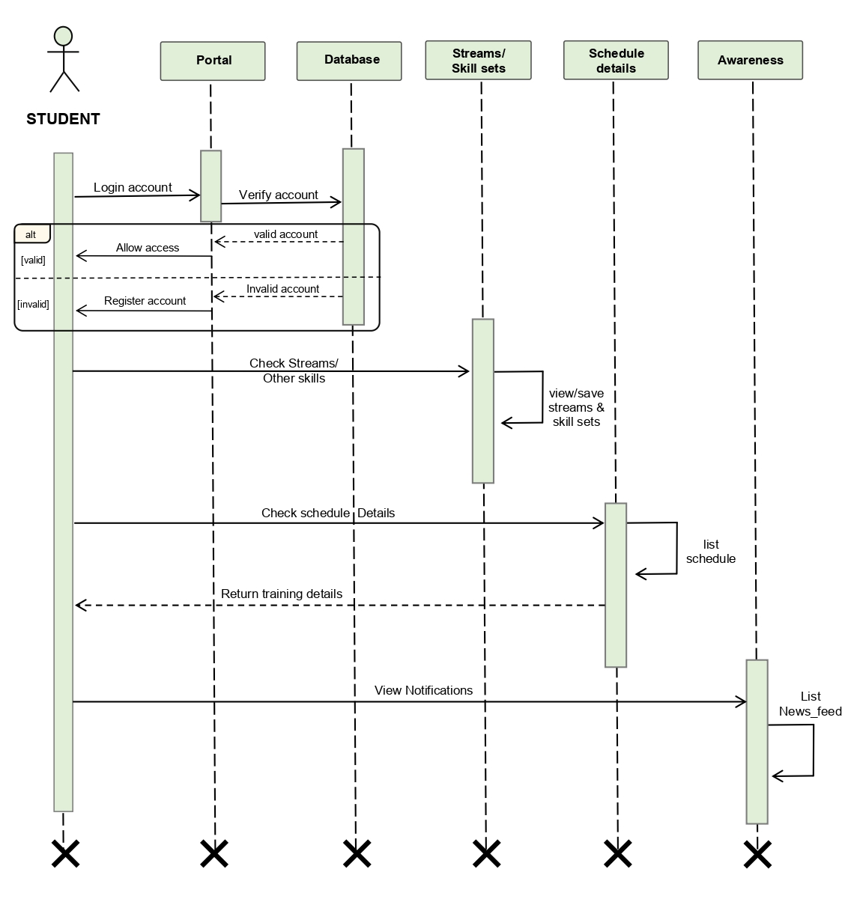
SEQUENCE DIAGRAM [student]

Slide 14
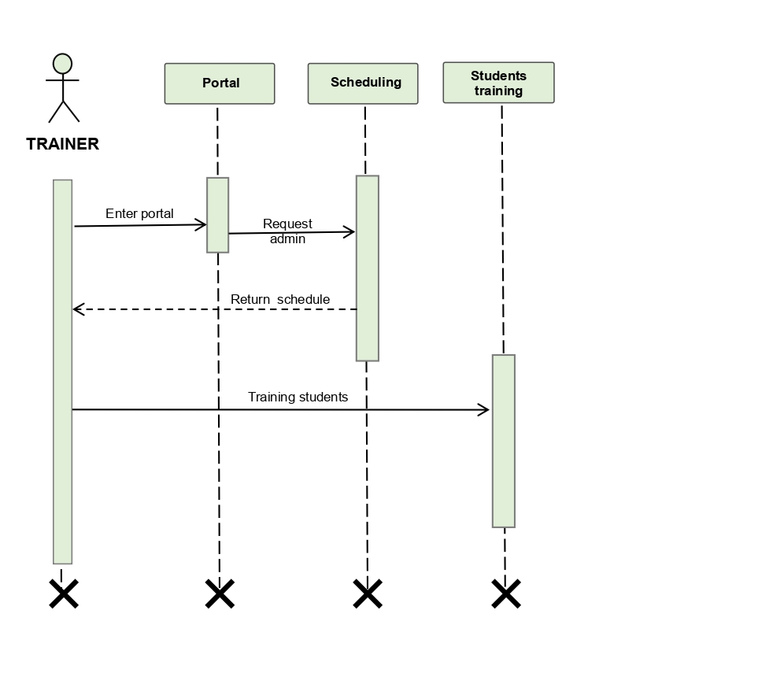
SEQUENCE DIAGRAM [Trainer]

Slide 15
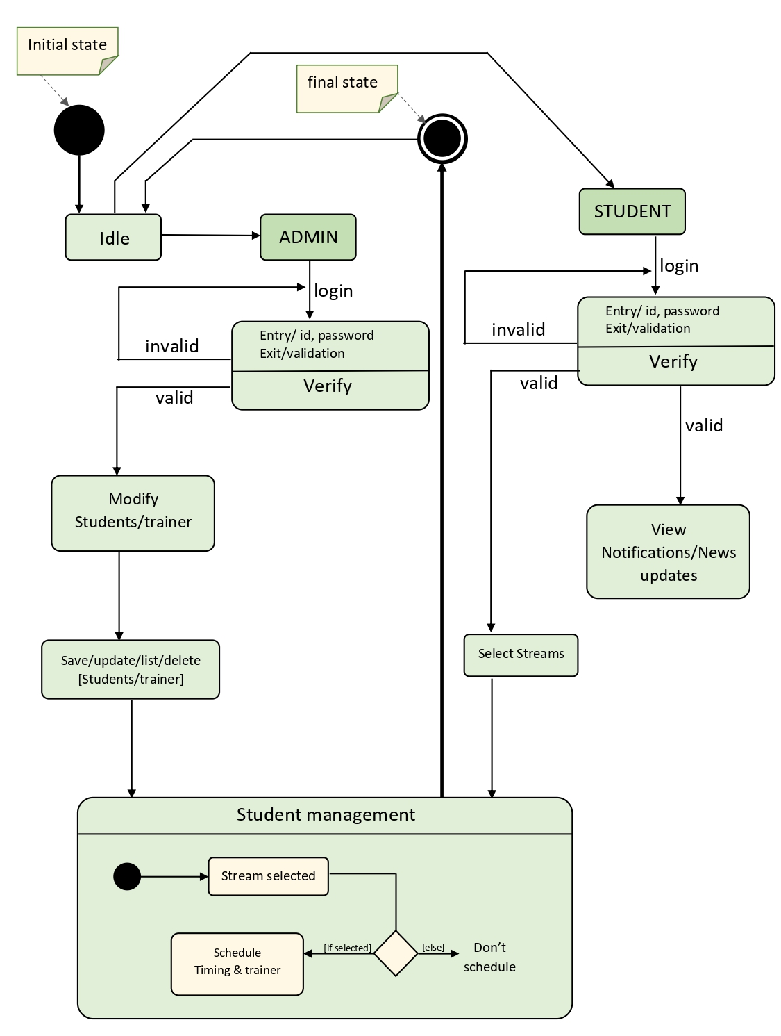
STATE CHART DIAGRAM

Slide 16
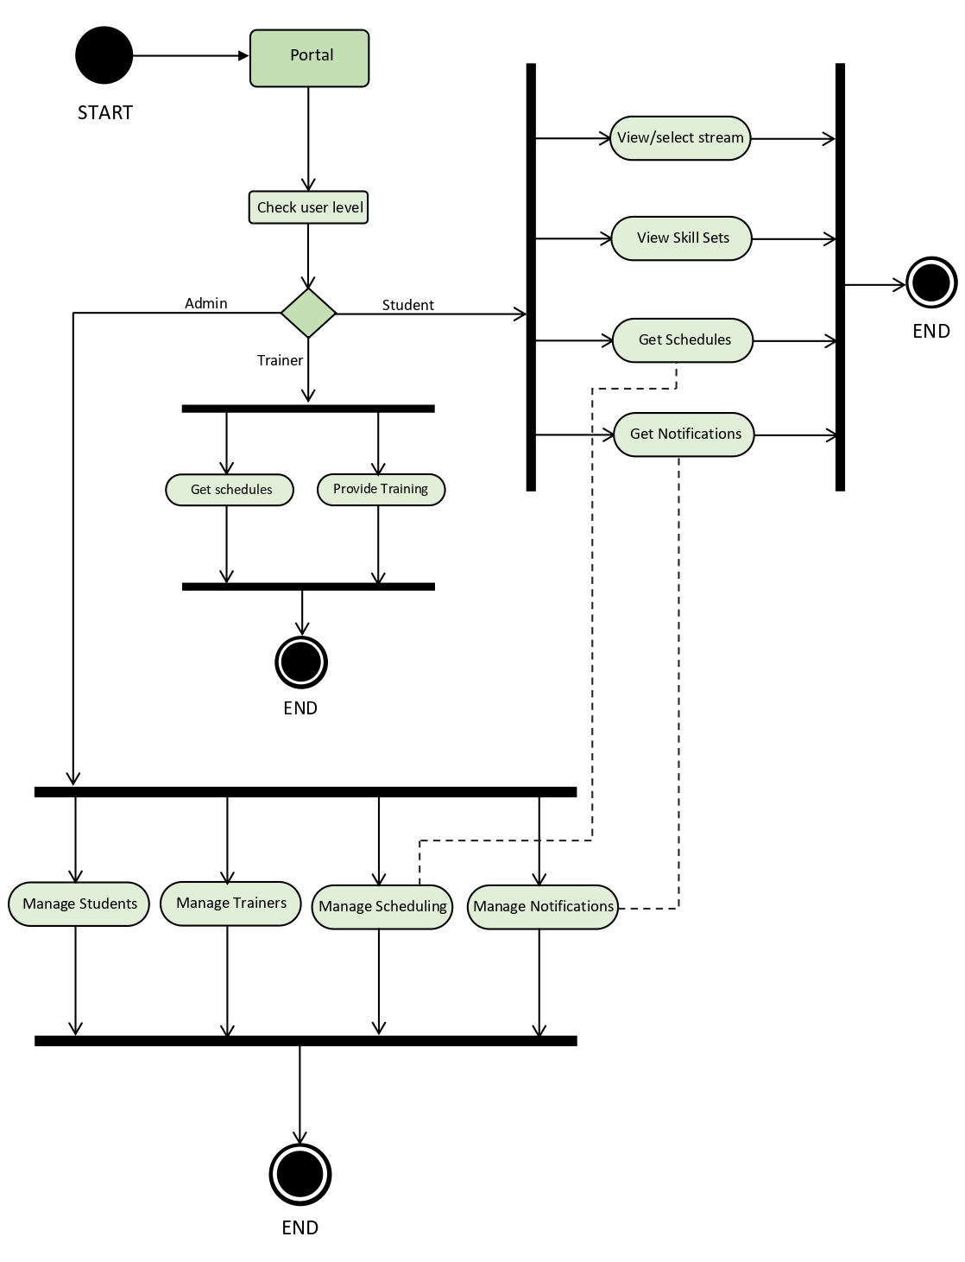
ACTIVITY DIAGRAM

Slide 17
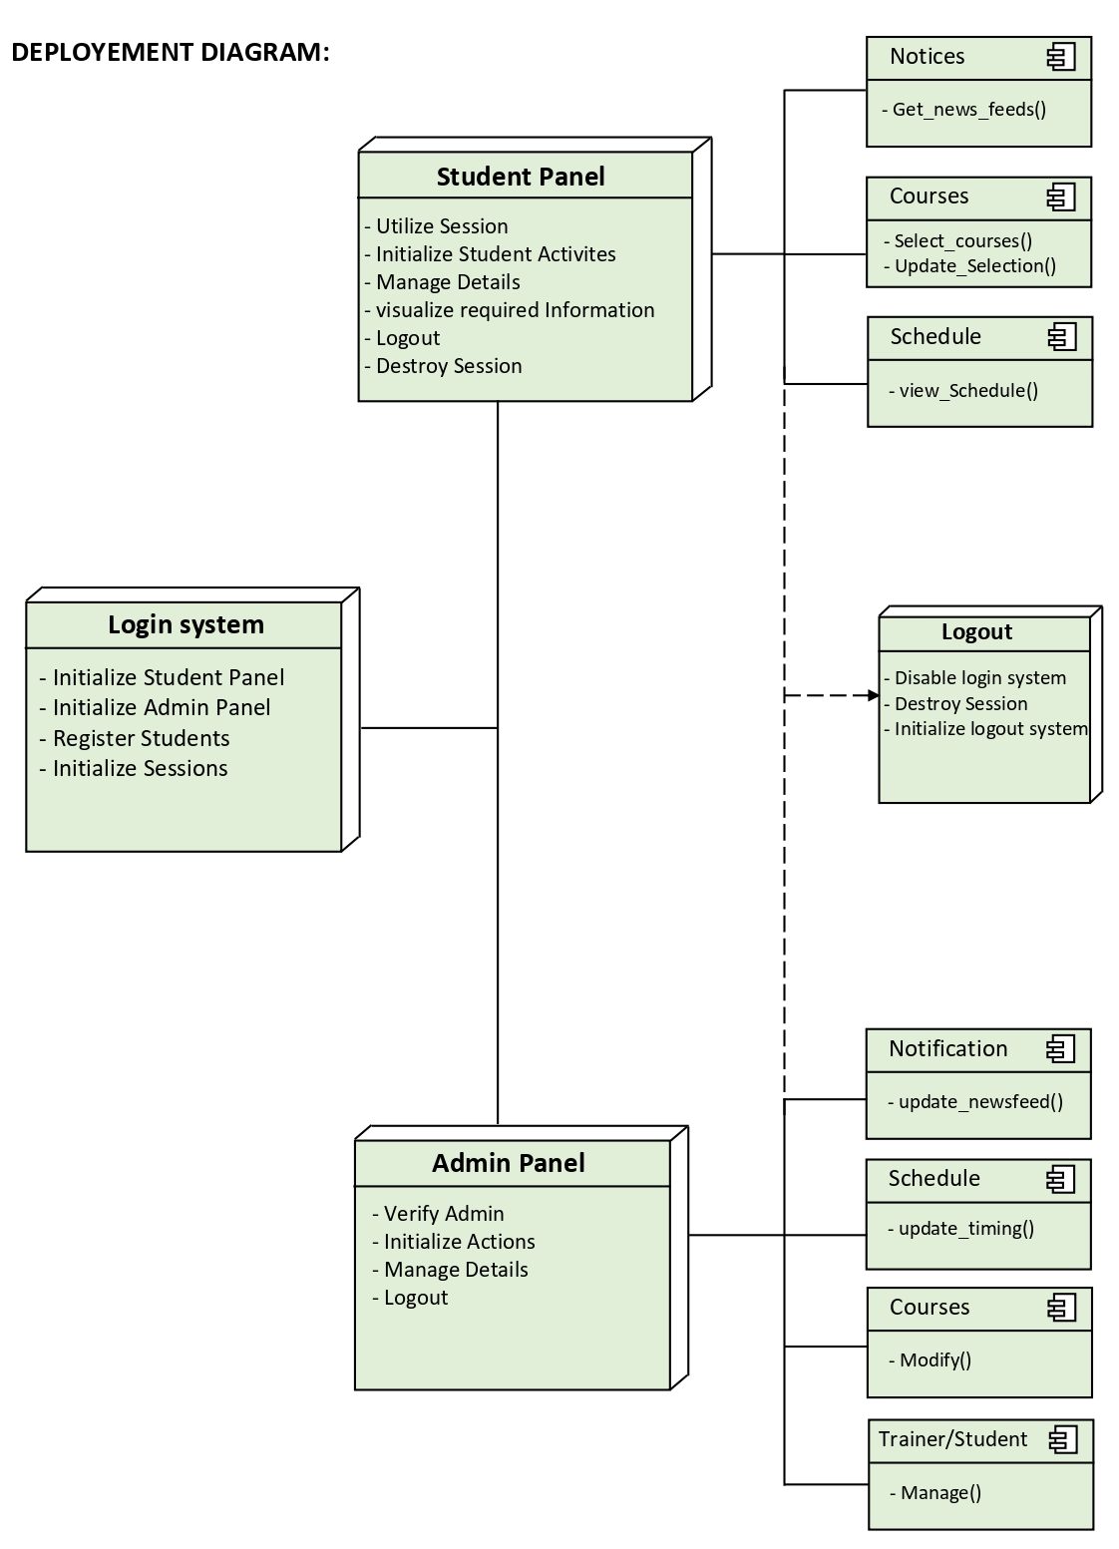
DEPLOYMENT DIAGRAM

Slide 18
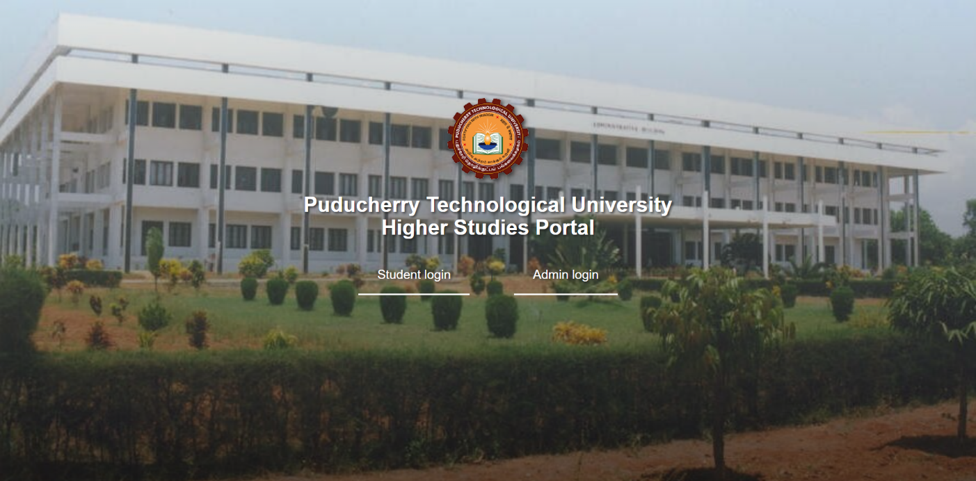
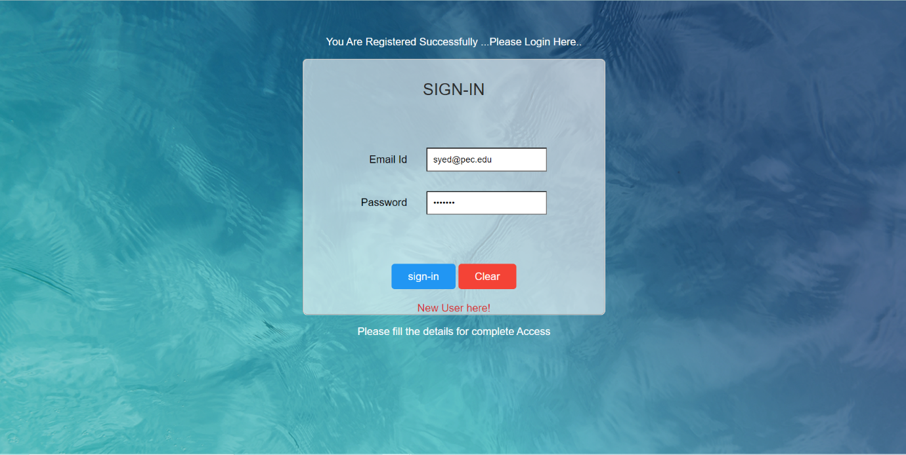
SCREENSHOTS [at user side]
Main-page : The mainpage of the web Application is used to navigate between admin/user.
Login : Login page used to check the credentials of the students accessing the portal.

Slide 19
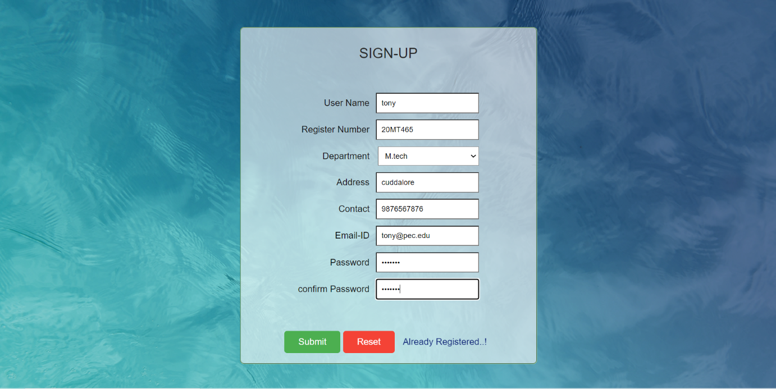
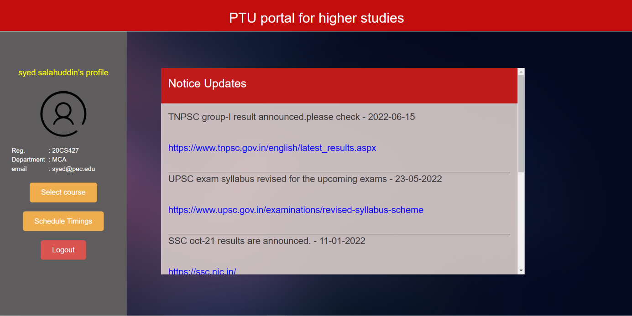
Registration : Registration page is used to register the new students for the portal.
Homepage : This is the Homepage for the User side, displaying the updated news, and links to open the course page and the scheduling page.

Slide 20
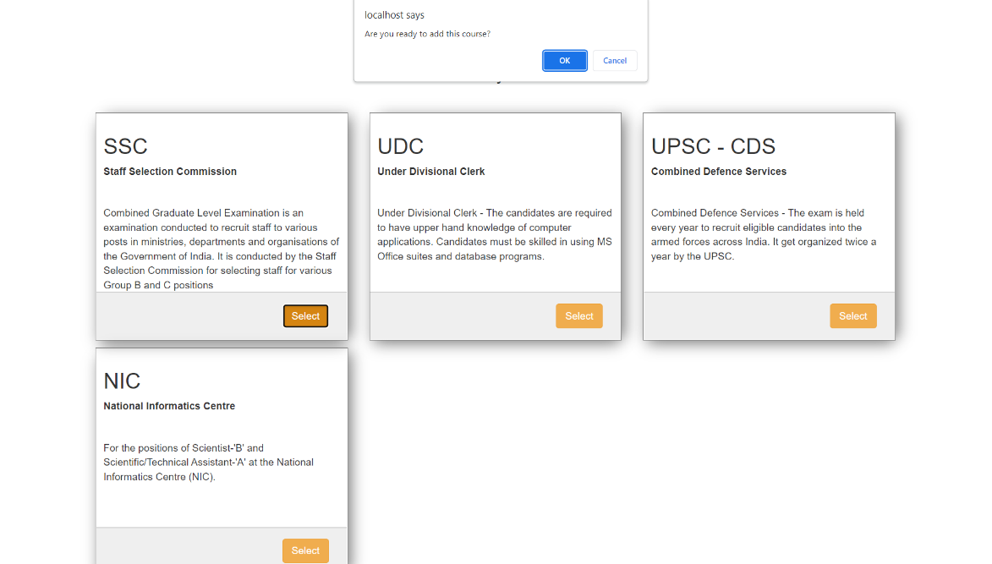
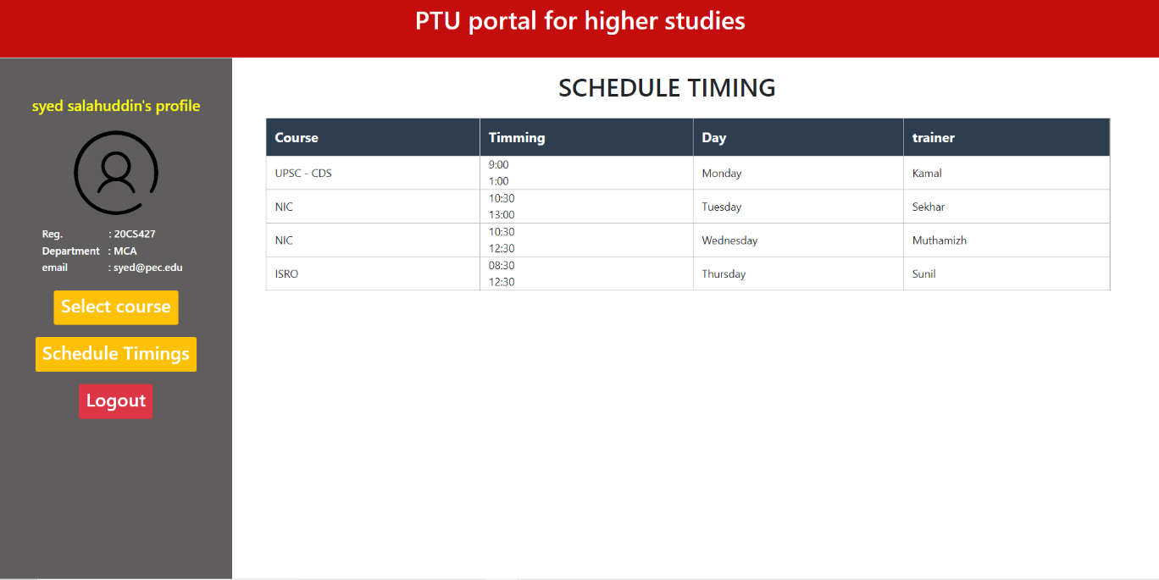
Course-page : This is the course-page for the User side, displaying the available courses for their Degree mentioned. Then the user can select the course easily by just click select.
Schedule-page : This page is for the User side, displays the available Schedule timings, including details, like course, timings, weekdays, and trainers who handles the course.

Slide 21
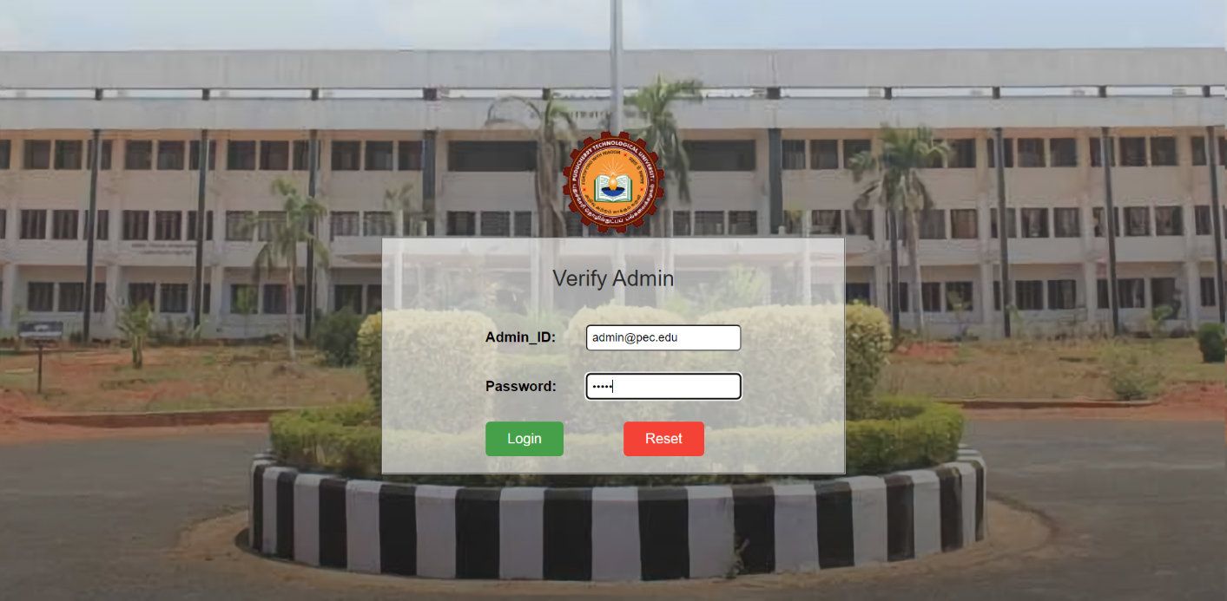
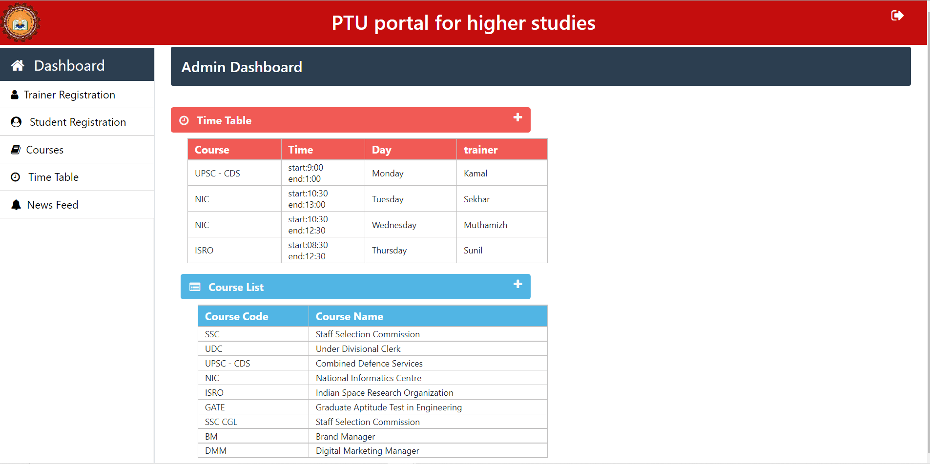
SCREENSHOTS [at admin side]
Login-page : checks the admin Credentials to allow access for the portal
Homepage : This is the homepage for the admin, which display the Schedule timings, available courses list and option buttons to perform operations.

Slide 22
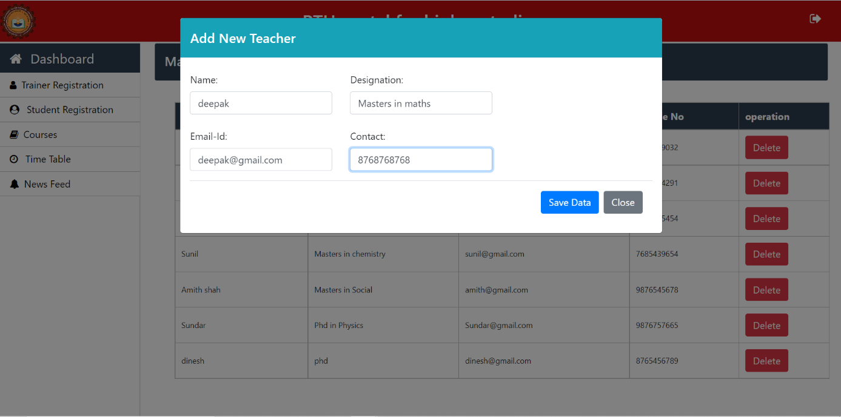
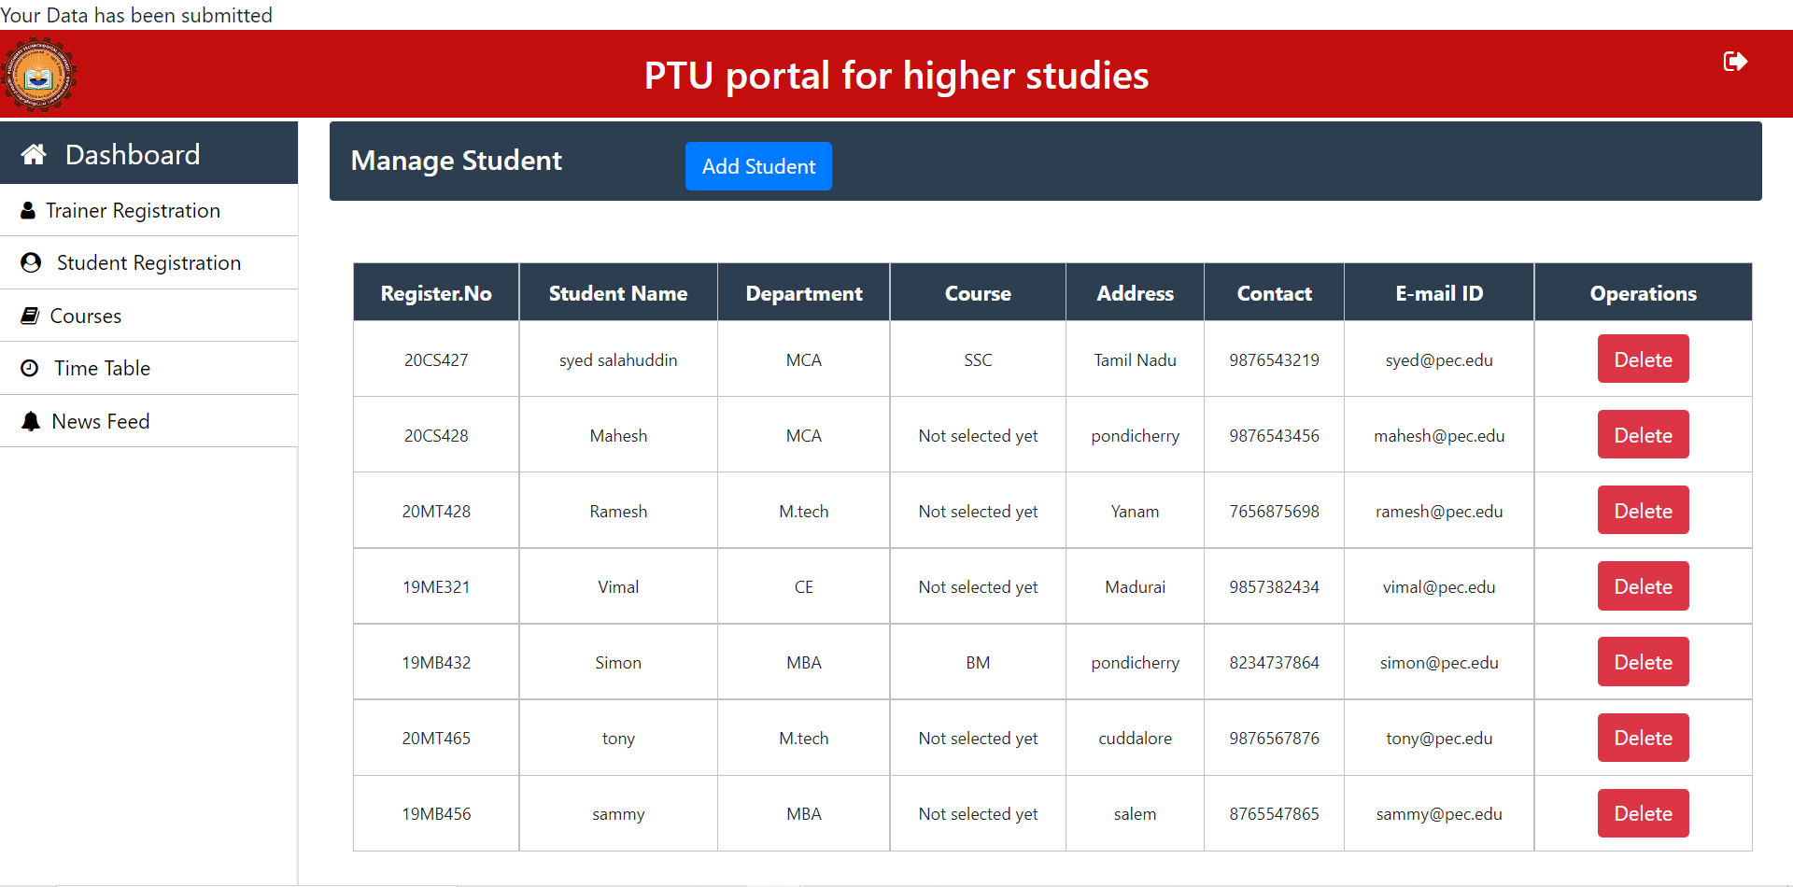
Trainer Registration : In Trainer registration page the Admin can manage the details of the Trainers by managing them like, add a new Trainer Data entry, delete the available Trainers entry if admin wants to.
Student Registration : In Student registration page the Admin view all the details of the registered students in the portal and can also manage them by deleting their details or can also add a new student entry if admin wants to.

Slide 23
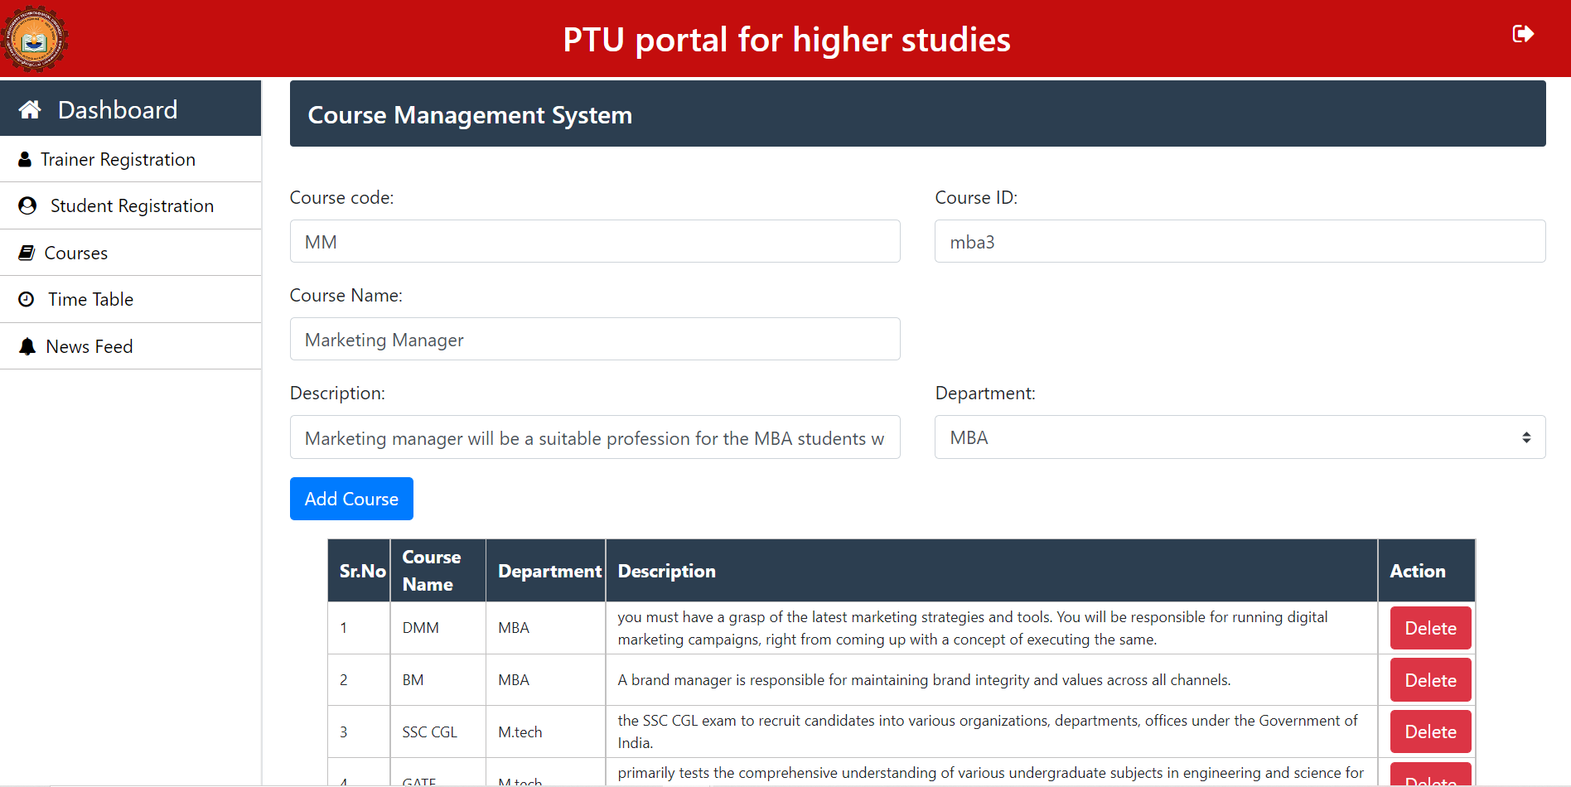
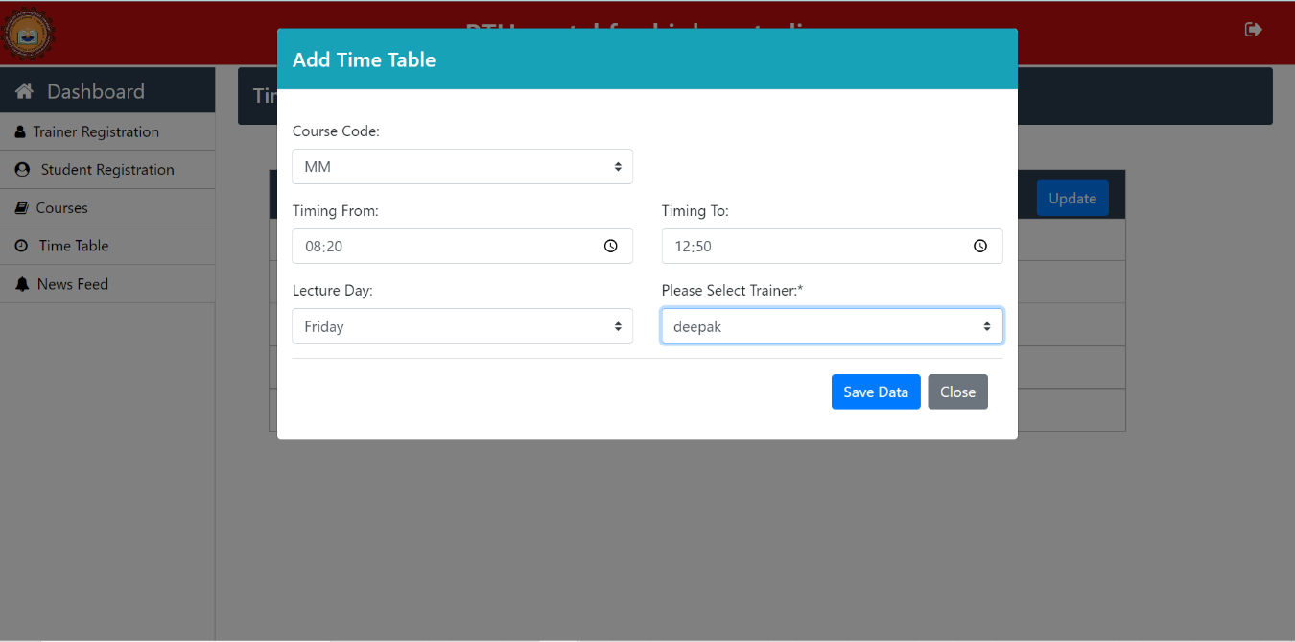
Course-page : This course page in the Admin dashboard is used to maintain the courses available for the students which are made to training. Thus maintaining which course is available for which stream is an vital aspect.
Schedule-Time : This schedule time page is used to allocate the trainer to the teach the specific course class on a specific day with specific timing. Thus this page helps the admin to create time scheduling.

Slide 24
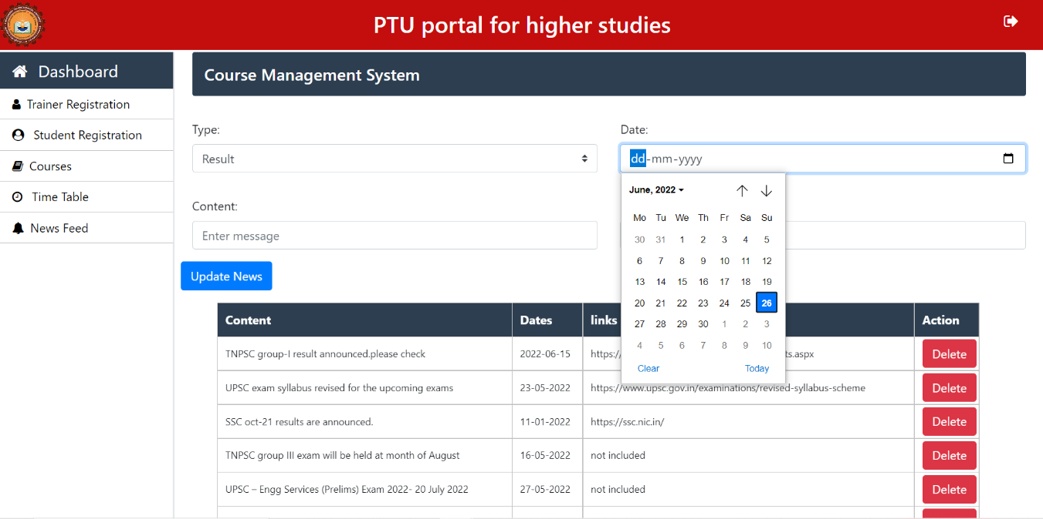
Newsfeed : This newsfeed page is used by admin to upload the daily new updates, generally about the notice, or the result dates announcement, or any new admission opens, etc.

Slide 25

THANK YOU

